Slide 1
Chapter 4 – the final fight

Slide 2
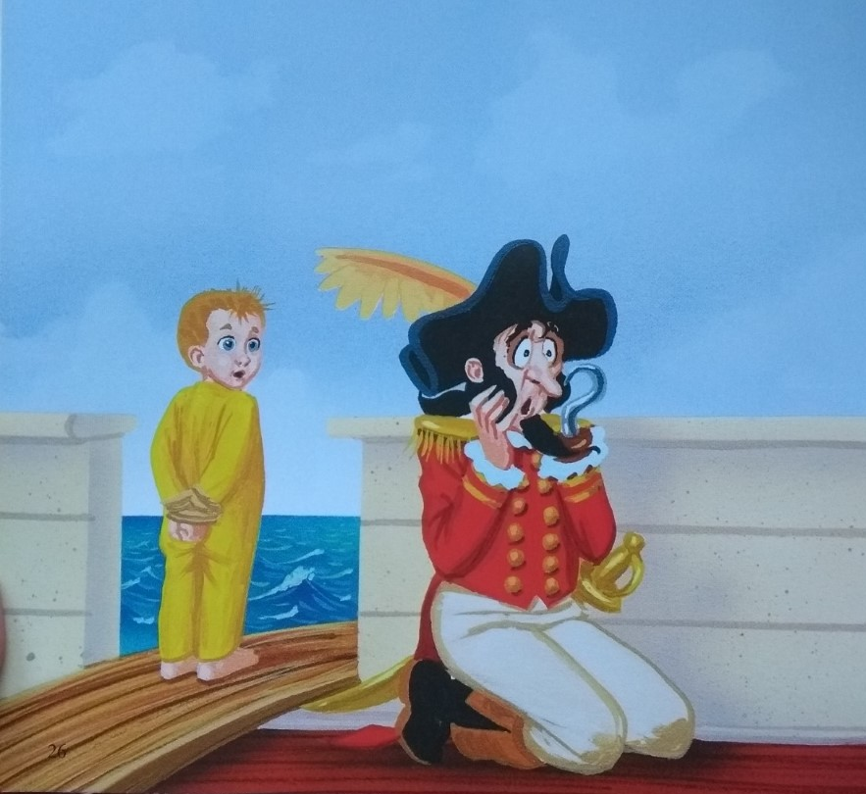
Chapter 4 – Final fight

Slide 3
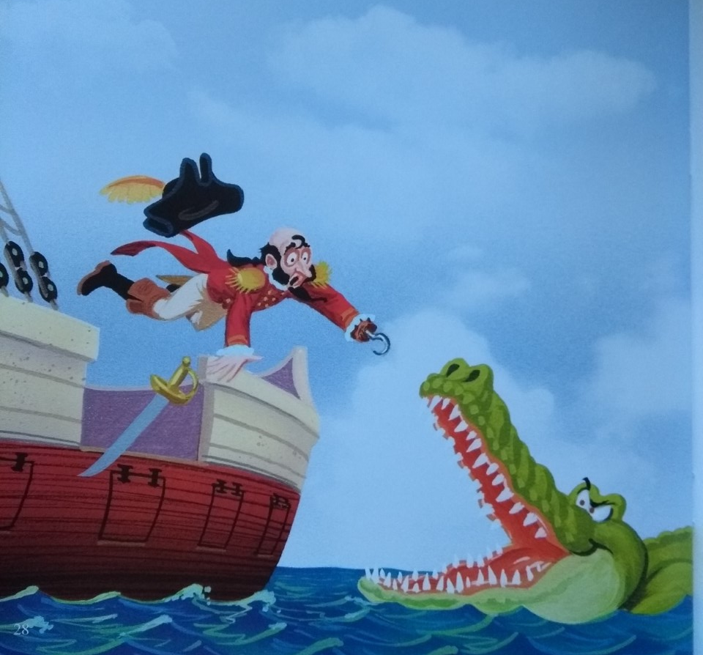

Slide 4
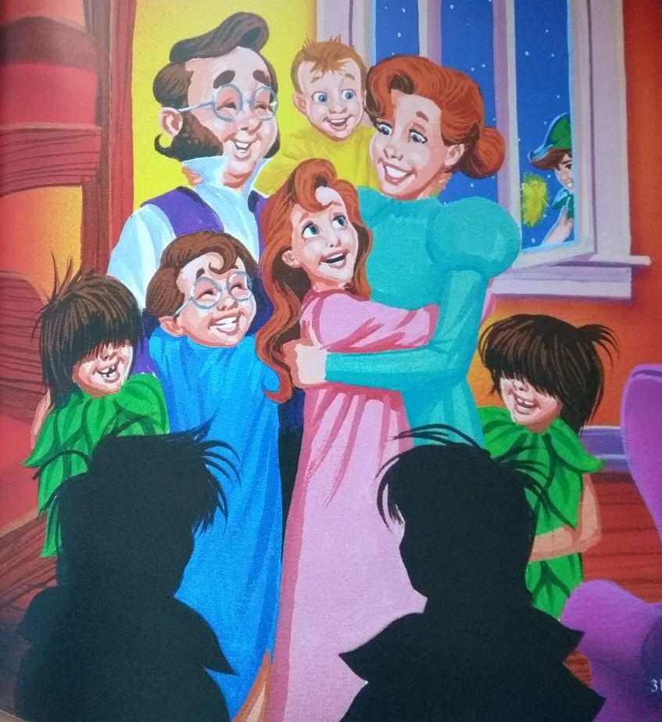

Slide 5
